Slide 1

Flappy Bird version cse472
Ao Ma

Slide 2
Unity
Unity is a cross-platform game engine developed by Unity Technologies, first announced and released in June 2005 at Apple Inc.'s Worldwide Developers Conference as a Mac OS X-exclusive game engine. As of 2018, the engine had been extended to support more than 25 platforms. The engine can be used to create three-dimensional, two-dimensional, virtual reality, and augmented reality games, as well as simulations and other experiences. The engine has been adopted by industries outside video gaming, such as film, automotive, architecture, engineering and construction.

Slide 3
Play method
You can use your mouse to click, and cse472 bird can start to jump, and you need to pass out all the water tube to get score. Once you touch the tube or touch the ground, you will be game over.

Slide 4
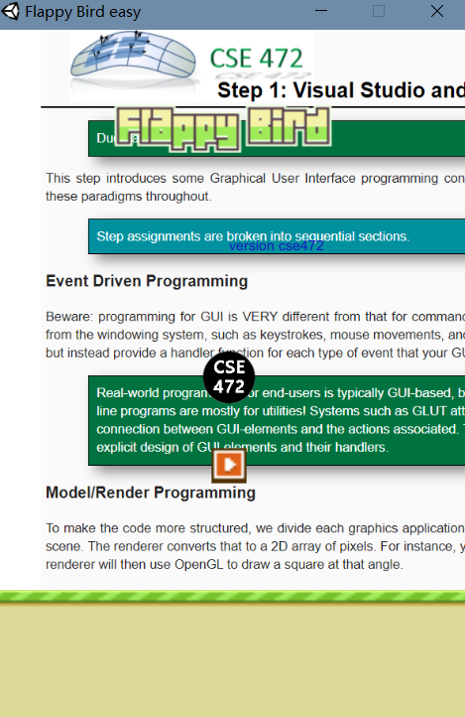
Game Demo

Slide 5
Thank you!

